Slide 1
Algorithmic Trading using Machine Learning
By Krishil Gandhi (U20EC013) & Kaushal Sheth(U20EC048)

Slide 2
What Algo Trading?
Algorithmic trading is a system that utilizes very advanced mathematical models for making transaction decisions in the financial markets.
Algorithmic trading (also called automated trading, black-box trading, or algo-trading) uses a computer program that follows a defined set of instructions (an algorithm) to place a trade. The trade, in theory, can generate profits at a speed and frequency that is impossible for a human trader.
The defined sets of instructions are based on timing, price, quantity, or any mathematical model. Apart from profit opportunities for the trader, algo-trading renders markets more liquid and trading more systematic by ruling out the impact of human emotions on trading activities.

Slide 3
Advantages of Algorithmic Trading
Best Execution: Trades are often executed at the best possible prices.
Low Latency: Trade order placement is instant and accurate (there is a high chance of execution at the desired levels). Trades are timed correctly and instantly to avoid significant price changes.
Reduced transaction costs.
Simultaneous automated checks on multiple market conditions.
No Human Error: Reduced risk of manual errors or mistakes when placing trades. Also negates human traders; tendency to be swayed by emotional and psychological factors.
Backtesting: Algo-trading can be backtested using available historical and real-time data to see if it is a viable trading strategy.

Slide 4
Disadvatages
Latency: Algorithmic trading relies on fast execution speeds and low latency, which is the delay in the execution of a trade. If a trade is not executed quickly enough, it may result in missed opportunities or losses.
Black Swan Events: Algorithmic trading relies on historical data and mathematical models to predict future market movements. However, unforeseen market disruptions, known as black swan events, can occur, which can result in losses for algorithmic traders.
Dependence on Technology: Algorithmic trading relies on technology, including computer programs and high-speed internet connections. If there are technical issues or failures, it can disrupt the trading process and result in losses.
Market Impact: Large algorithmic trades can have a significant impact on market prices, which can result in losses for traders who are not able to adjust their trades in response to these changes. Algo trading has also been suspected of increasing market volatility at times, even leading to so-called flash crashes.
Regulation: Algorithmic trading is subject to various regulatory requirements and oversight, which can be complex and time-consuming to comply with.
High Capital Costs: The development and implementation of algorithmic trading systems can be costly, and traders may need to pay ongoing fees for software and data feeds.
Limited Customization: Algorithmic trading systems are based on pre-defined rules and instructions, which can limit the ability of traders to customize their trades to meet their specific needs or preferences.
Lack of Human Judgment: Algorithmic trading relies on mathematical models and historical data, which means that it does not take into account the subjective and qualitative factors that can influence market movements. This lack of human judgment can be a disadvantage for traders who prefer a more intuitive or instinctive approach to trading.

Slide 5
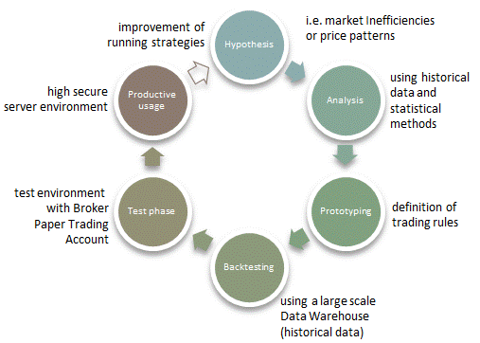
Basic Steps in Algo Trading

Slide 6
Types of Algo Trading Strategies in Real World
Market Making Strategies
Arbitrage Strategies
Statistical Strategies
Momentum Strategies
Sentiment Based Trading Strategies
Machine Learning Trading Strategies

Slide 7
ML in Algo Trading
Data quality is critical to machine learning. Machine learning algorithms must be trained on accurate and comprehensive historical data, or they will never provide reliable predictions. Ideally, the data should be normalized, and it should include a wide range of relevant indicators for the asset you’re interested in.
The main rationale for applying ML to trading is to obtain predictions of asset fundamentals, price movements or market conditions. A strategy can leverage multiple ML algorithms that build on each other. Downstream models can generate signals at the portfolio level by integrating predictions about the prospects of individual assets, capital market expectations, and the correlation among securities. Alternatively, ML predictions can inform discretionary trades as in the quantamental approach outlined above. ML predictions can also target specific risk factors, such as value or volatility, or implement technical approaches, such as trend following or mean reversion.

Slide 8
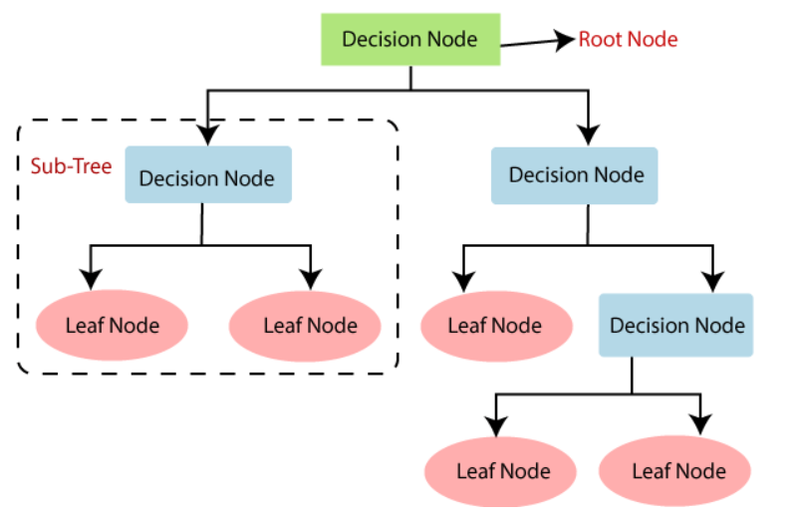
Decision Tree Algorithm
Decision Tree is a Supervised learning technique that can be used for both classification and Regression problems, but mostly it is preferred for solving Classification problems. It is a tree-structured classifier, where internal nodes represent the features of a dataset, branches represent the decision rules and each leaf node represents the outcome.

Slide 9
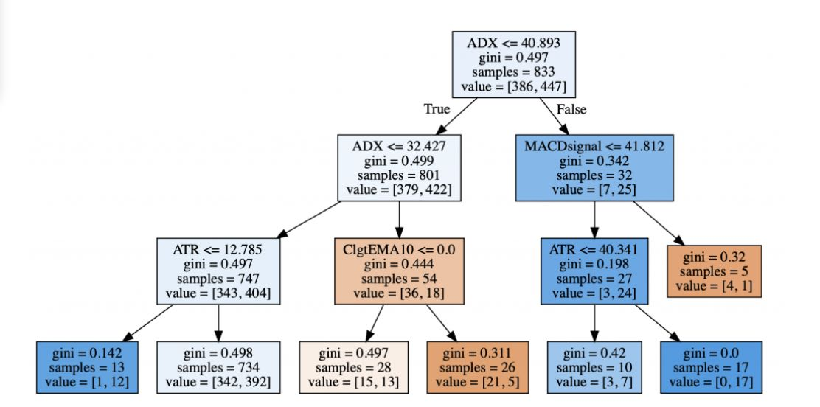
Decision Tree output

Slide 10
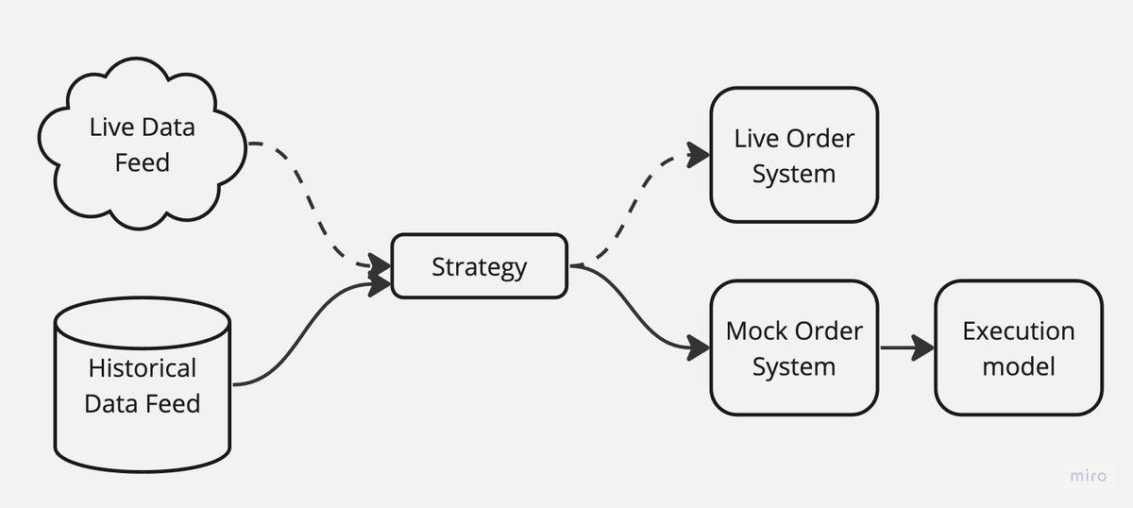
Backtesting
Backtesting of predicted dataset is done by using zipline

Slide 11
Results
We compares results of both algorithm with and without using machine learning.
Benchmark annual profit:- 24%
Net annual profit :- 6% (without ML)
Net annual profit :- 27% (with ML)

Slide 12
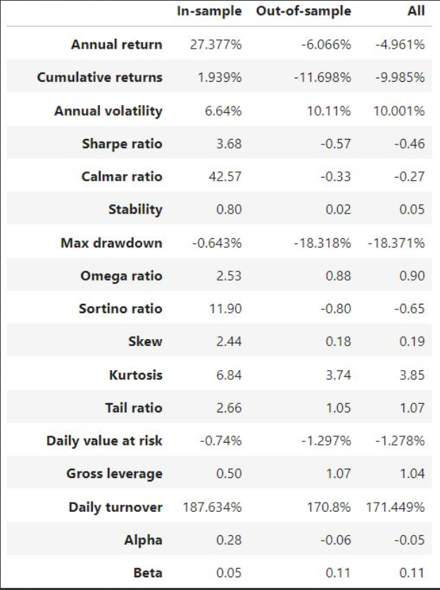
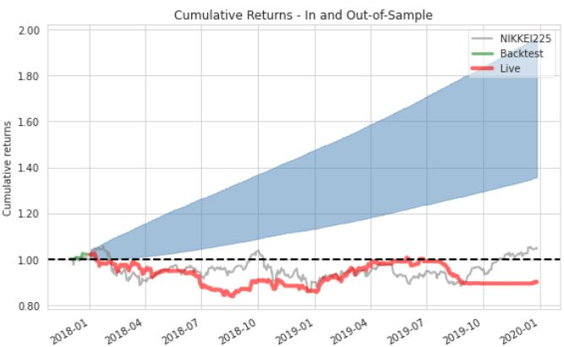

Slide 13
Conclusion
Thus, we have used Decision Tree for Algorithmic Trading to improve our algorithms’
decision-making and increase profit. We have found that by using Decision Tree, our
return found it to be 27.37 percent which is much higher than traditional Algorithms
based MACD and RSI, which has the return of 6 percent. Thus, this proves that using
Machine Learning algorithms can significantly improve the algorithm. In the Future, we
can use more sophisticated and advanced algorithms, such as Support Vector Machines,
Gradient Boosting, and other boosting algorithms, to improve the returns on our im-
provement. Further, we can use reinforcement learning, making it much more resilient
to sudden changes in conditions and even stronger in bringing more returns.

Slide 14
THANK YOU

